Slide 1







A Netflix Proposal
Produced by:
Travis Cook
Matthew Groh
Marshal Rittenger
Julia Olson

Slide 2


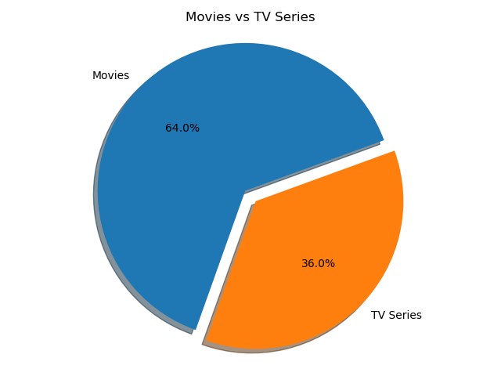

Should we make a movie or TV series?

Slide 3





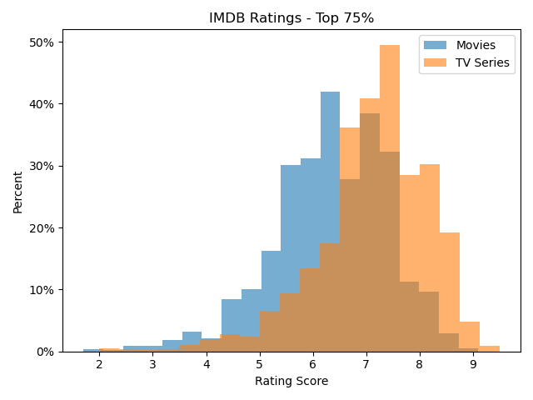
T-Test: IMDB Scores of
Movies & TV Series
pvalue = 1.988 e-100

Slide 4

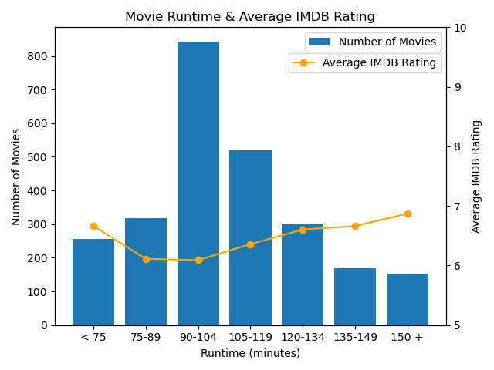
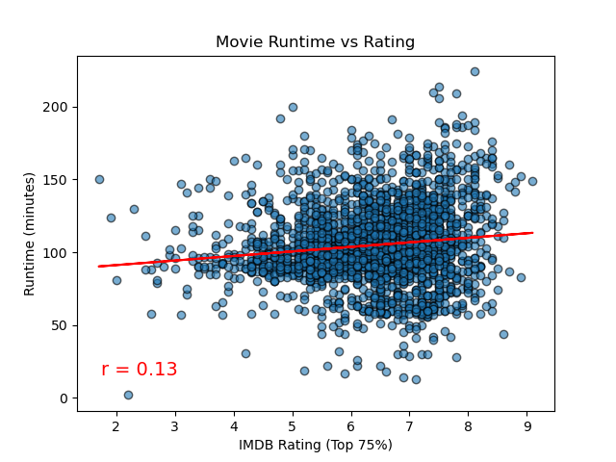
How long should our movie be?
Is there correlation between length and rating?

Slide 5

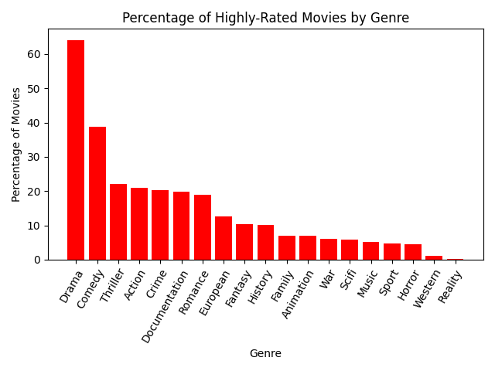
What genres are most popular?
Filtered by the top rated movies by genre.

Slide 6

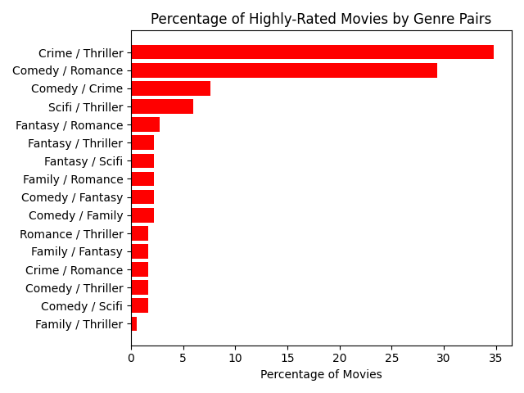
What genres will our film be?

Slide 7

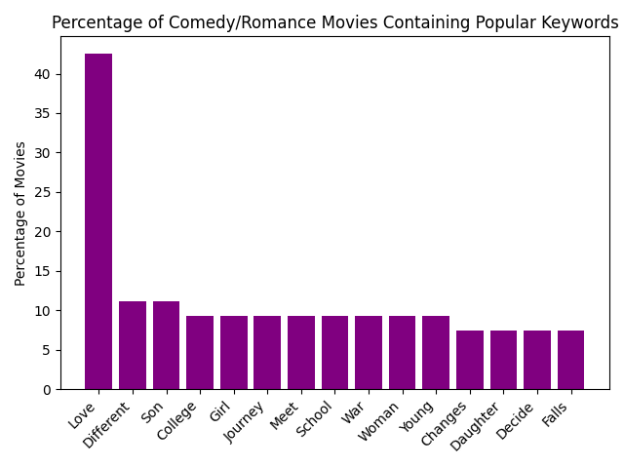
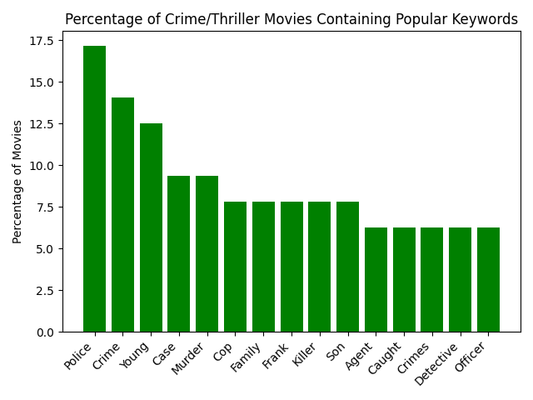
Which themes will be in our movie?

Slide 8
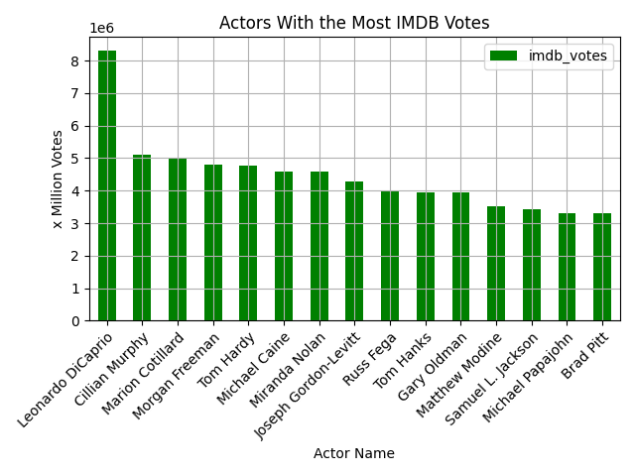
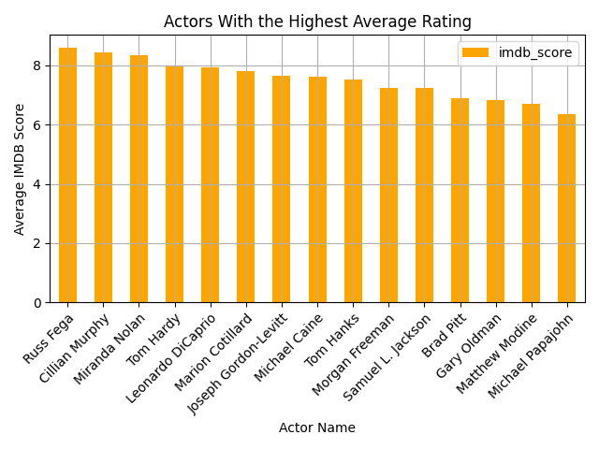

Who is our ideal cast?
Top 15 Actors by IMDB Votes

Slide 9
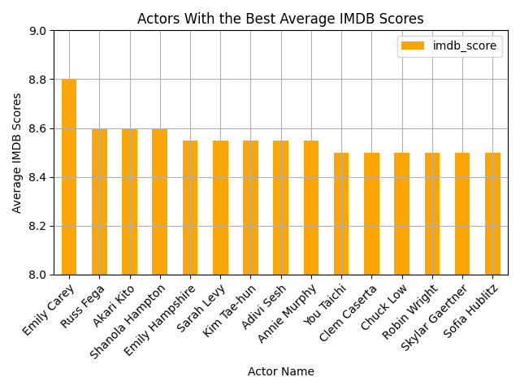
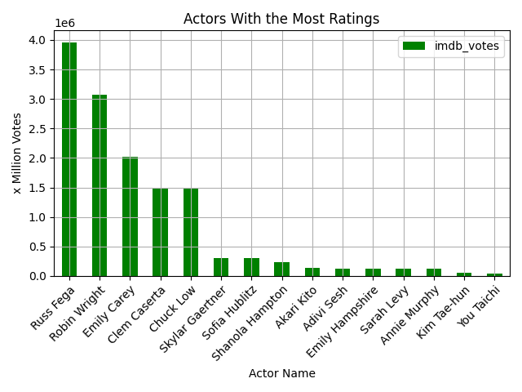

Who is our ideal cast?
Top 15 Actors by IMDB Scores

Slide 10

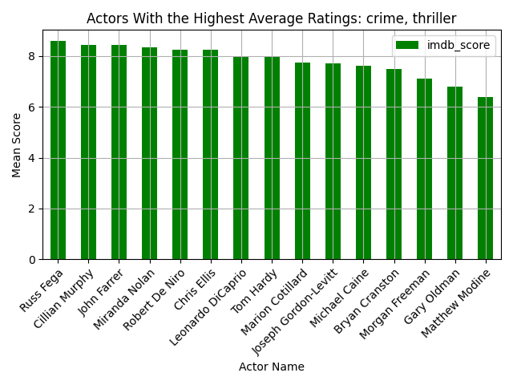
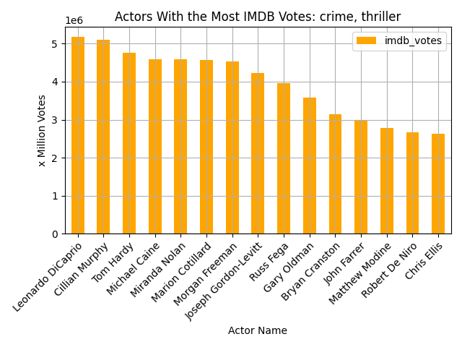


Who is our ideal cast?
Top 15 Actors by Genre (crime & thriller)
Selection
Omission

Slide 11

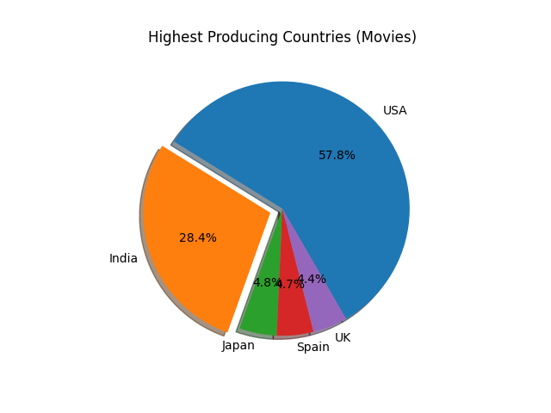

Which countries should we partner with?

Slide 12

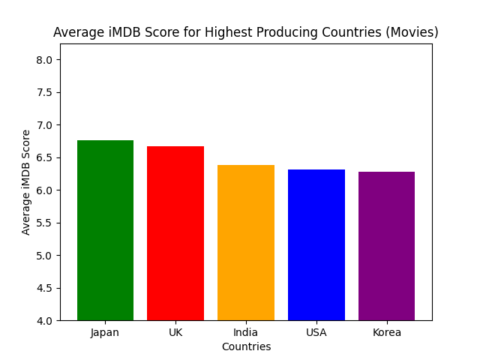
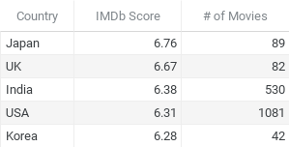
Which countries have the highest rating?
Highest Scores by Country

Slide 13

Our Netflix proposal:
Movies/TV Series:
Runtime:
Genres:
Themes:
Cast:
Production Countries:
Movie
104 Minutes
Crime/Thriller
Comedy/Romance
Police, Crime, Murder, Youth, Case,
Love, Different, Son, College, Girl,
Journey
Leonardo DiCaprio
Cillian Murphy
Shanola Hampton
Emily Hampsire
United States
India
Japan

Slide 14

Crossing Borders
In this global crime odyssey, Detective Frank (Leonardo DiCaprio) partners with his quirky sidekick, Murphy (Cillian Murphy), and the dynamic duo of Detective Harper (Shanola Hampton) and Forensic Expert Turner (Emily Hampshire). Together, they embark on a murder investigation spanning the United States, India, and Japan. As they navigate diverse landscapes, the case becomes entangled with college life, revealing unexpected love stories amid the complexities of the crime. This thrilling crime-comedy promises suspense, laughter, and cross-cultural surprises with a stellar ensemble cast.

Slide 15
Investor Questions?

